Slide 1
Karnaugh Map Generator
20011689 박민선(Minsun Park)

Slide 2
Contents
Introduction
Preconditions and Restrictions
Setting Values for Each Terms
Setting Karnaugh Map
Sum of Product, Product of Sum
Karnaugh Map Result

Slide 3
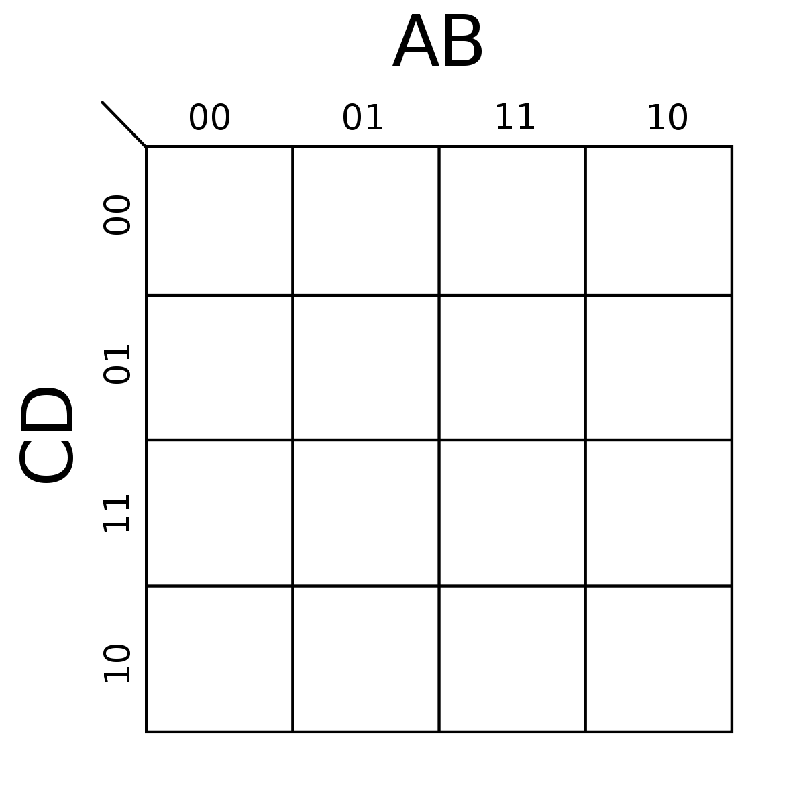
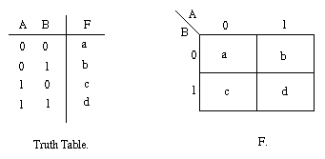
Introduction
I chose this topic because I had a lot of difficulty whenever I was building a Karnaugh map for digital logic design class
Thus I decided to make a Karnaugh map generator to solve this problem

Slide 4
Preconditions and restrictions
It can accept only between 2 and 4 variables
It cannot generate an equation based on the given information, so it will generate only the chart
Not only it can set 1 and 0, but it can also set “don’t cares” as X
It can generate different maps in sum of product and product of sum

Slide 5
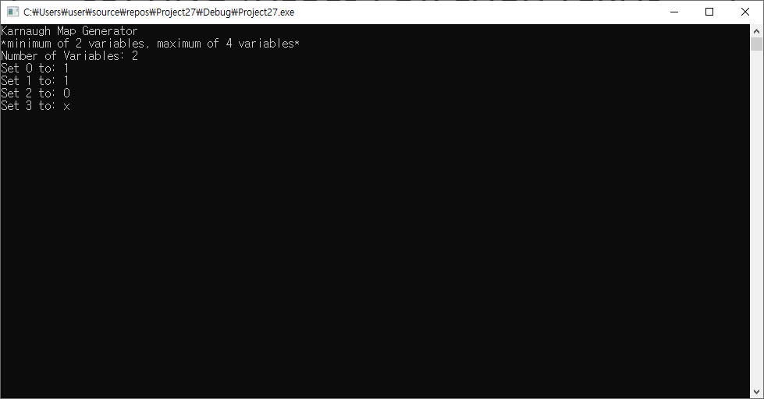
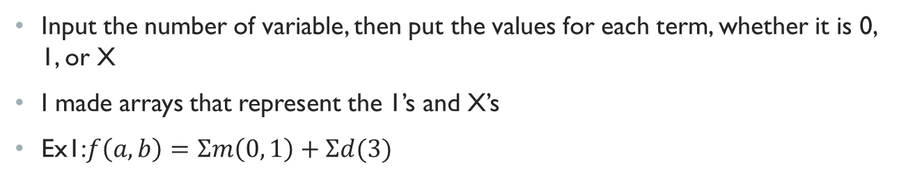
Setting values for each terms
Input the number of variable, then put the values for each term, whether it is 0, 1, or X
I made arrays that represent the 1’s and X’s
Ex1:$f\left(a,b\right)=Σm\left(0, 1\right)+Σd(3)$

Slide 6
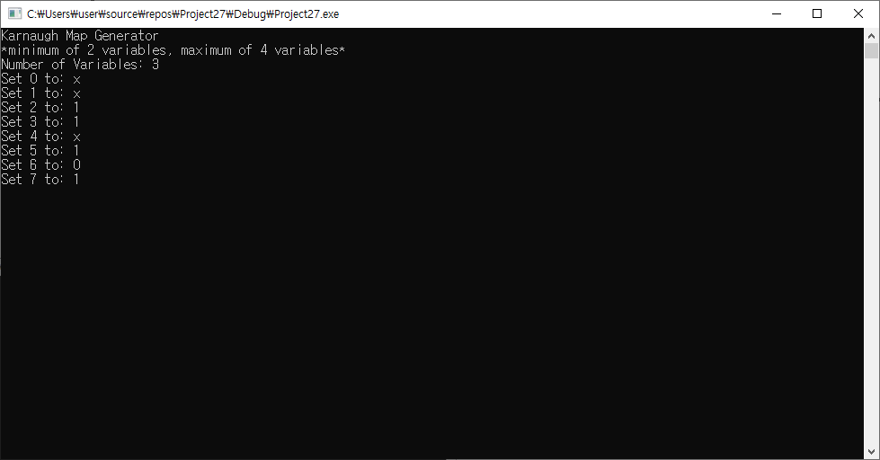
Setting values for each terms
Ex2: $f\left(a,b,c\right)=Σm\left(2, 3, 5, 7\right)+Σd(0, 1, 4)$

Slide 7
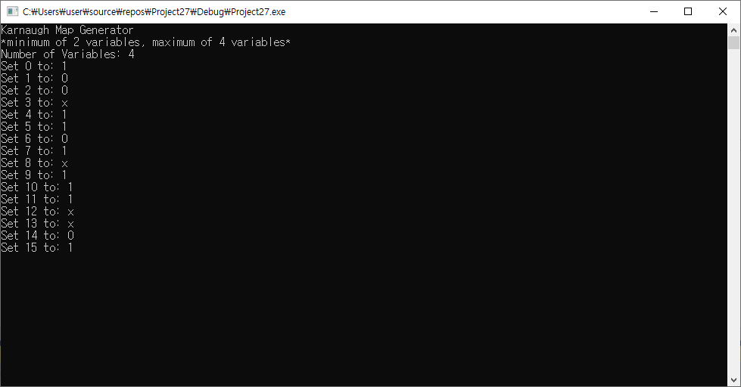
Setting values for each terms
Ex3: $f\left(a,b,c,d\right)=Σm\left(0, 4, 5, 7, 9, 10, 11, 15\right)+Σd(3, 8, 12, 13)$

Slide 8
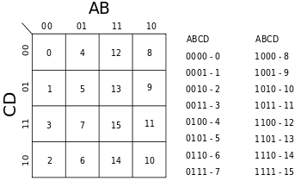
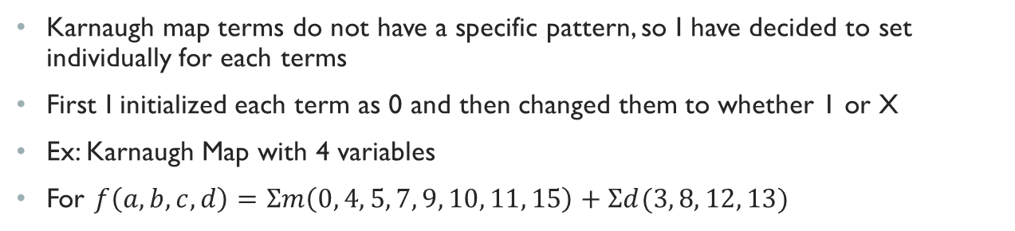
Setting Karnaugh map
Karnaugh map terms do not have a specific pattern, so I have decided to set individually for each terms
First I initialized each term as 0 and then changed them to whether 1 or X
Ex: Karnaugh Map with 4 variables
For $f\left(a,b,c,d\right)=Σm\left(0, 4, 5, 7, 9, 10, 11, 15\right)+Σd(3, 8, 12, 13)$
1 1 X X
0 1 X 0
X 1 1 1
0 0 0 1

Slide 9
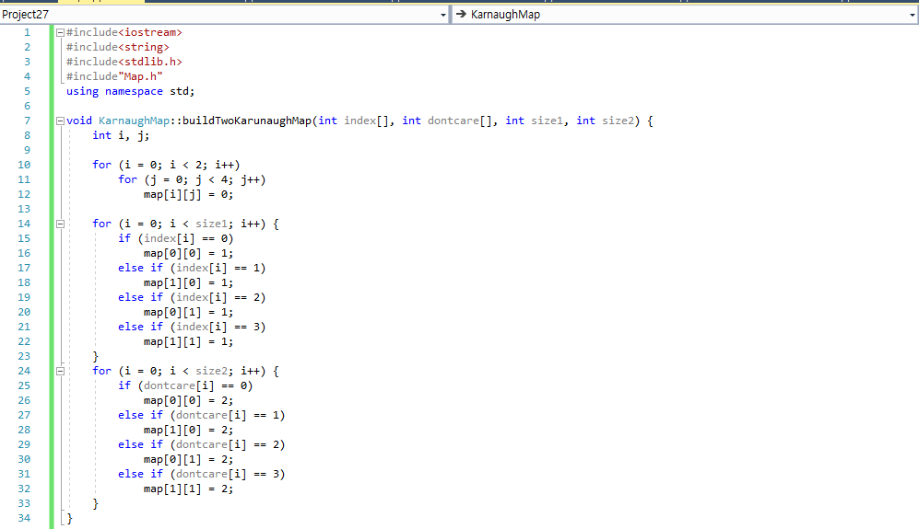
Setting Karnaugh map 2 variables

Slide 10
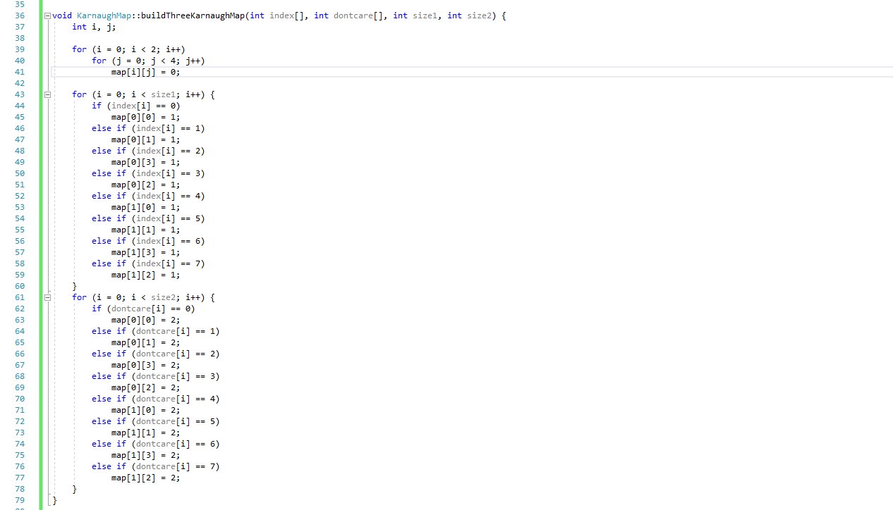
Setting Karnaugh map 3 variables

Slide 11
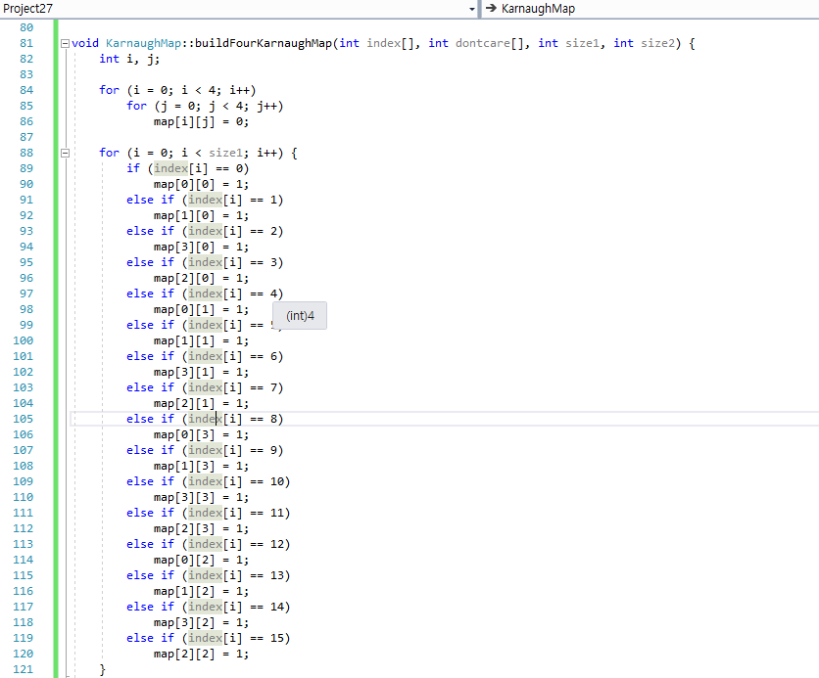
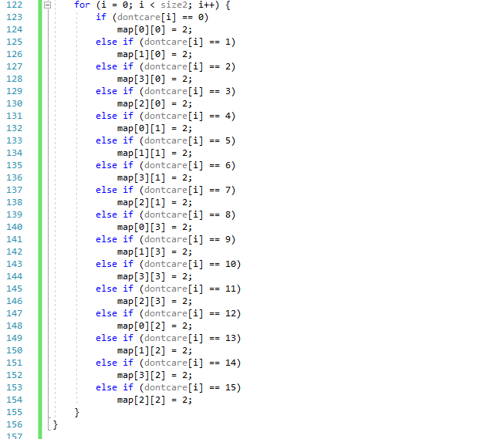
Setting Karnaugh map 4 variables

Slide 12
Sum of product, product of sum
After inputting all the values for each term, the program will ask whether it wants to generate the map in sum of product or product of sum
The input will be 1 or 0: 1 representing sum of product and 0 representing product of sum
If the input value is 1, the terms will be maintained, but if the value is 0, 1’s will change to 0’s and 0’s will change to 1’s
The don’t care value, X, will not change

Slide 13
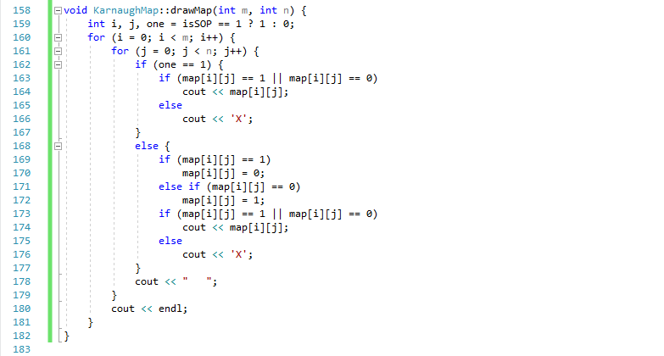
Sum of product, product of sum

Slide 14
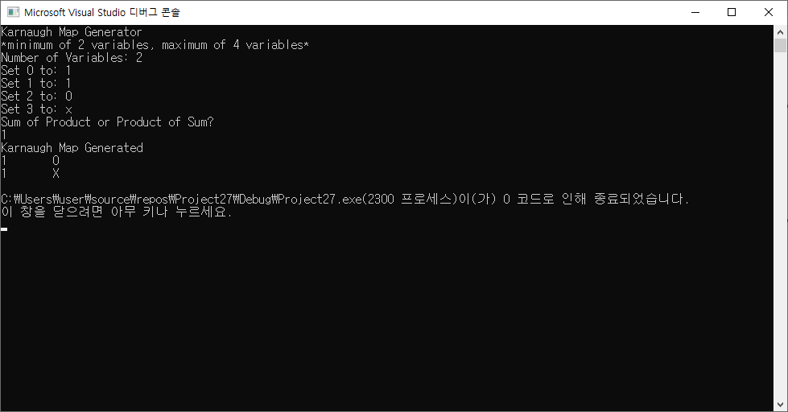
Karnaugh map result
Ex1: $f\left(a,b\right)=Σm\left(0, 1\right)+Σd(3)$ in sum of product form

Slide 15
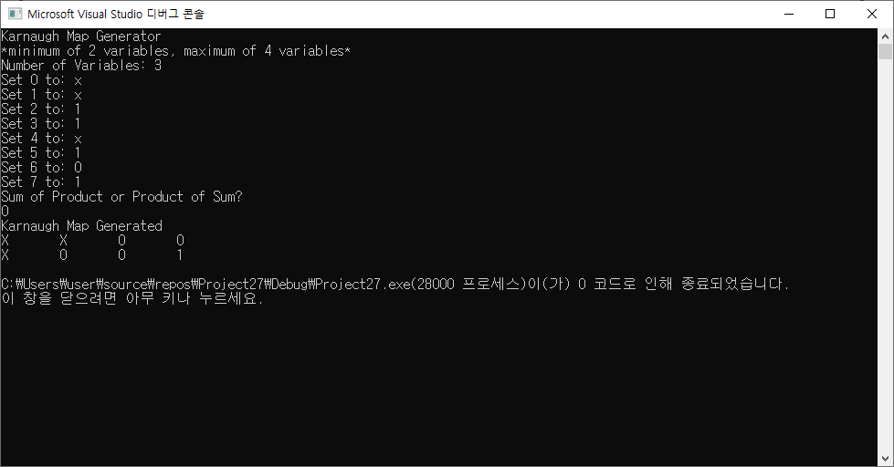
Karnaugh map result
Ex2: $f\left(a,b,c\right)=Σm\left(2, 3, 5, 7\right)+Σd(0, 1, 4)$ in product of sum form

Slide 16
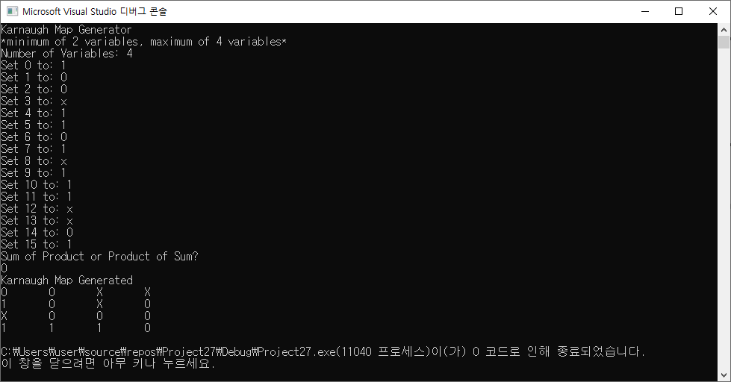
Karnaugh map result
Ex3: $f\left(a,b,c,d\right)=Σm\left(0, 4, 5, 7, 9, 10, 11, 15\right)+Σd(3, 8, 12, 13)$ in product of sum form

Slide 17
Thank you for watching
The codes are in the same folder as the ppt file
They are also below, check hyperlink
Map.h code.txt
Map.cpp code.txt

